Slide 1

Title: Recovering Root Password in Red Hat Enterprise Linux
Subtitle: Step-by-step guide to resetting the root user password.
Marieswaran M / Advantage Pro

Slide 2
Real-Time Scenario
Problem Statement:
Imagine you are a system administrator managing multiple servers in a data center.
One day, you need to perform critical maintenance on a Red Hat Enterprise Linux (RHEL) server. However,
when you try to log in as the root user, you realize that:
1. The root password is lost or forgotten.
2. No other user has administrative privileges.
3. You must regain access without reinstalling the OS or losing data.

Slide 3
Solution:
1. Utilize GRUB bootloader to reset the root password.
2. Gain access to the system by editing the boot parameters.
3. Securely reset the root password and ensure system integrity.
Objective:
By the end of this session, you will be able to:
✅ Reset the root password on a RHEL server.
✅ Use GRUB in recovery mode to regain system access.
✅ Secure the system after password recovery.

Slide 4
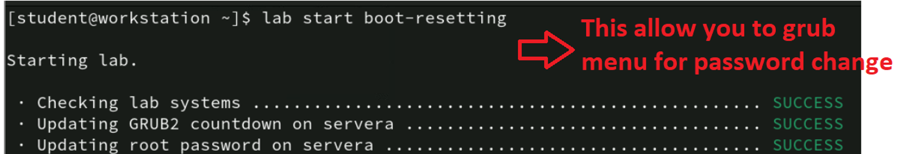
Step 1: Start the Lab Command
Run the following command from student@workstation:
lab start boot-resetting
Purpose: Initializes the GRUB menu for password change.
Lab Execution: Checks and updates GRUB, resets root password, installs rescue kernel, and reboots the server.

Slide 5
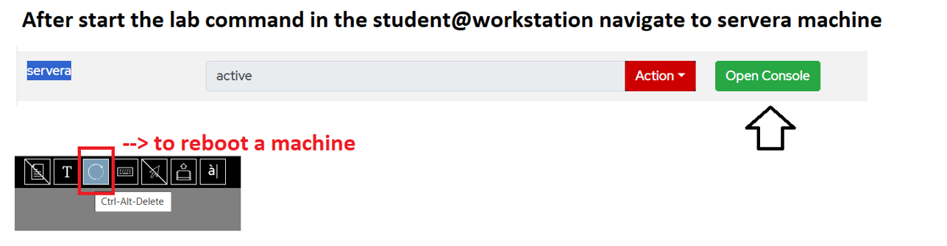
Step 2: Accessing Server Console
Navigate to servera machine.
Click Action → Open Console.
Reboot the machine using Ctrl+Alt+Delete.

Slide 6

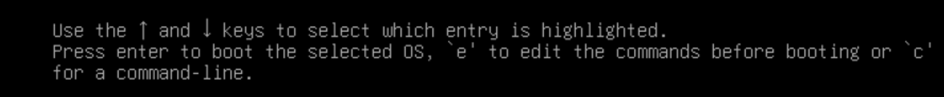
Step 3: Entering GRUB Menu
GRUB menu appears after reboot.
Press the down arrow to stop the timer.
Press 'e' to edit the selected entry.

Slide 7
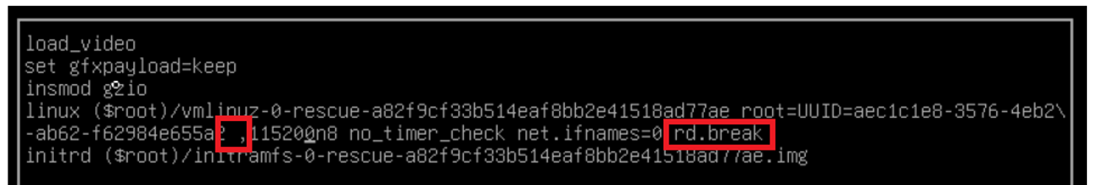
Step 4: Editing the GRUB Configuration
Locate the linux line.
Remove both console=tty0 and console=ttys0.
Ensure there is one space for a comma.
Append rd.break at the end of the 4th line.

Slide 8
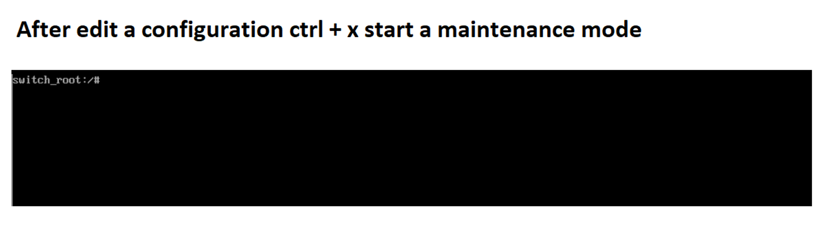
Step 5: Entering Maintenance Mode
Press Ctrl+X to start in maintenance mode.
You will now enter a shell prompt.

Slide 9
Step 6: Remounting and Changing Password
Remount the filesystem in read-write mode:
Switch_root: # mount -o remount,rw /sysroot
Change root environment:
sh5.4:# chroot /sysroot
Reset root password:
sh5.4:# passwd --stdin root
Update Password:
sh5.4:# touch /.autorelabel
Exit from chroot:
sh5.4:# exit

Slide 10
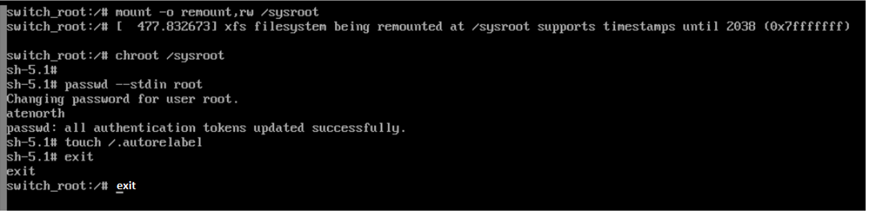
Exit From the Maintenance mode:
switch_root:# exit
System reboots with the new password.

Slide 11
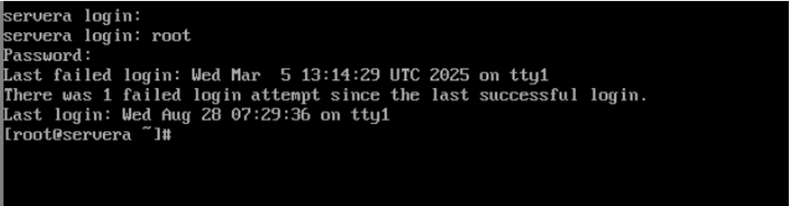
Step 8: Logging in with New Password
Login as root after reboot.
Verify successful password reset.
You are now able to access the system!
Video Attached Below Please Check it OUT

Slide 12
